Slide 1
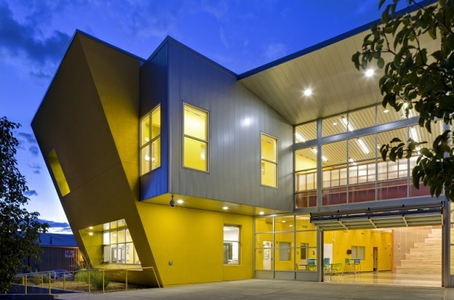
Career Enrichment Center

Slide 2
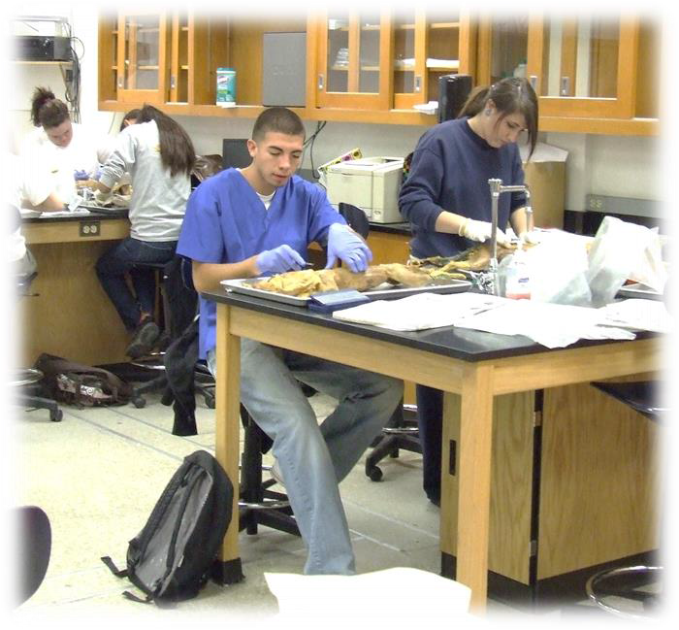
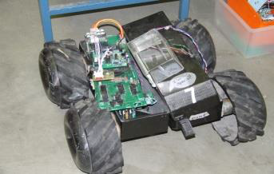

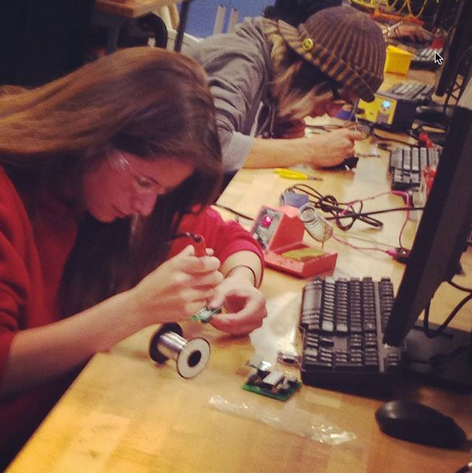
What is CEC?
CEC is the premier magnet school in APS. The Career Enrichment Center provides opportunities for advanced, in-depth learning. Students from all Albuquerque high schools may choose unique courses from a variety of career areas. The blending of strong academic, career, and technical classes is enhanced by the diversity of students from all over Albuquerque.

Slide 3
Who can register at CEC?
In order to apply to CEC, students must be in 10th grade and all applicants must have a strong academic background and specific skills related to course requirements. Students are selected on the basis of their grades, resume, references, and field experience.

Slide 4
When can you register for CEC?
Apply early. Completed applications (application, transcript, and placement testing) for the fall semester must be submitted as early as February 1st. Early College Academy application window is from November 1st until January 31st.

Slide 5
Where and how do you apply for CEC? How much does it cost?
You can download an application from the CEC website or you can come into CEC and apply in person.
CEC classes are FREE and transportation is provided.

Slide 6
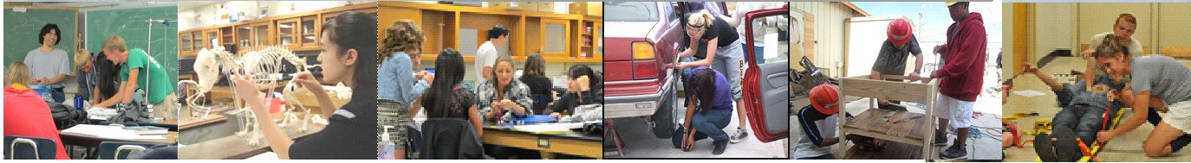
What can one study at CEC and for how long?
You can study Robotics, Computer Science, Webscripting, Animation, CAD, Forensics, Nursing, Banking and Finance, EMT, Automotive, etc (current course offerings listed on the back of information sheet). The length of the time you can be at CEC depends on your program of study.

Slide 7
What happens after CEC?
Students are encouraged to continue with their studies at UNM or other institutions that continue with the various programs of study offered at CEC. Some students will also be able to join the workforce immediately after the completion of their CEC certification programs (Nursing, Nursing Assistant, EMT, Automotive, etc).

Slide 8
Cec.aps.edu
Please visit our website for more info!!!

